Slide 1

Case Study
Presenter : Veera SP

Slide 2
Table of Contents
About | 3
Dataset & Methodology | 4
Analysis | 5
Action Plan | 12

Slide 3

About the dataset
A comprehensive analysis of DataCo Global's supply chain operations, revealing critical insights into delivery performance, revenue impact, and operational efficiency across 180K+ orders.
Aiming to uncover Systemic Issues in a $36.7M Revenue Dataset.
Data source : Kaggle (https://www.kaggle.com/code/simontagbor/demand-forecasting-and-inventory-optimisation/notebook)

Slide 4

Dataset & Methodology
Dataset Overview
Data Structure Hierarchy
Analytical Approach
Source: DataCo Global Supply Chain (Kaggle)
→ 20k Customers
Objective: Analyze impact of late deliveries on business performance
→ 65k Orders
Shape: 180,519 rows × 53 columns
→ 180k Order Items
Focus Areas: Revenue impact and risk, shipping performance
Content: Structured data
Granularity: Each row is a unique item in an order
Key Metrics: Late delivery ratio, Revenue at risk by late delivery
Customer Mix: 57% are repeat buyers
Scope: Global markets across 5 regions
Data Preparation
Removed: Redundant/null columns (e.g., zip codes)
Result: Analysis-ready dataset for comprehensive performance tracking and strategic decision making
Validated: No duplicate order items
Cleaned: Standardized data types for analysis
Outlier Analysis:
Sales has certain peaks and lows explaining the trends and patterns.
Product price has only 0.08% extreme values not affecting the mean.

Slide 5

Analysis of DataCo Global Supply Chain Data
Note: Keeping the date range from 1-Jan 2017 to 31-Dec-2017 for analysis purposes.

Slide 6

The Late Delivery Crisis
54.2%
6.4M $
29K
Revenue at Risk
Late Delivery Impact
Orders Affected
Over half of total revenue tied to late deliveries
Nearly 100K orders delivered behind schedule
Total revenue affected by delivery delays
Trends & Patterns
Consistent pattern: February lows, May peaks (2015-2017)
Concerning Trends: Sharp decline in Sept 2016, multiple dips in H2 2017
Action: Prepare for May peaks, investigate H2 2017 decline
Notes:
2017 trend analysis : * Order volumes dropped most likely due to consistent late deliveries. At first glance, sales and late orders move in the same direction because both scale with order volume. More orders mean more revenue but also naturally more delays.”
“This doesn’t prove whether late deliveries erode profitability, because at this level of aggregation, volume dominates the picture.

Slide 7
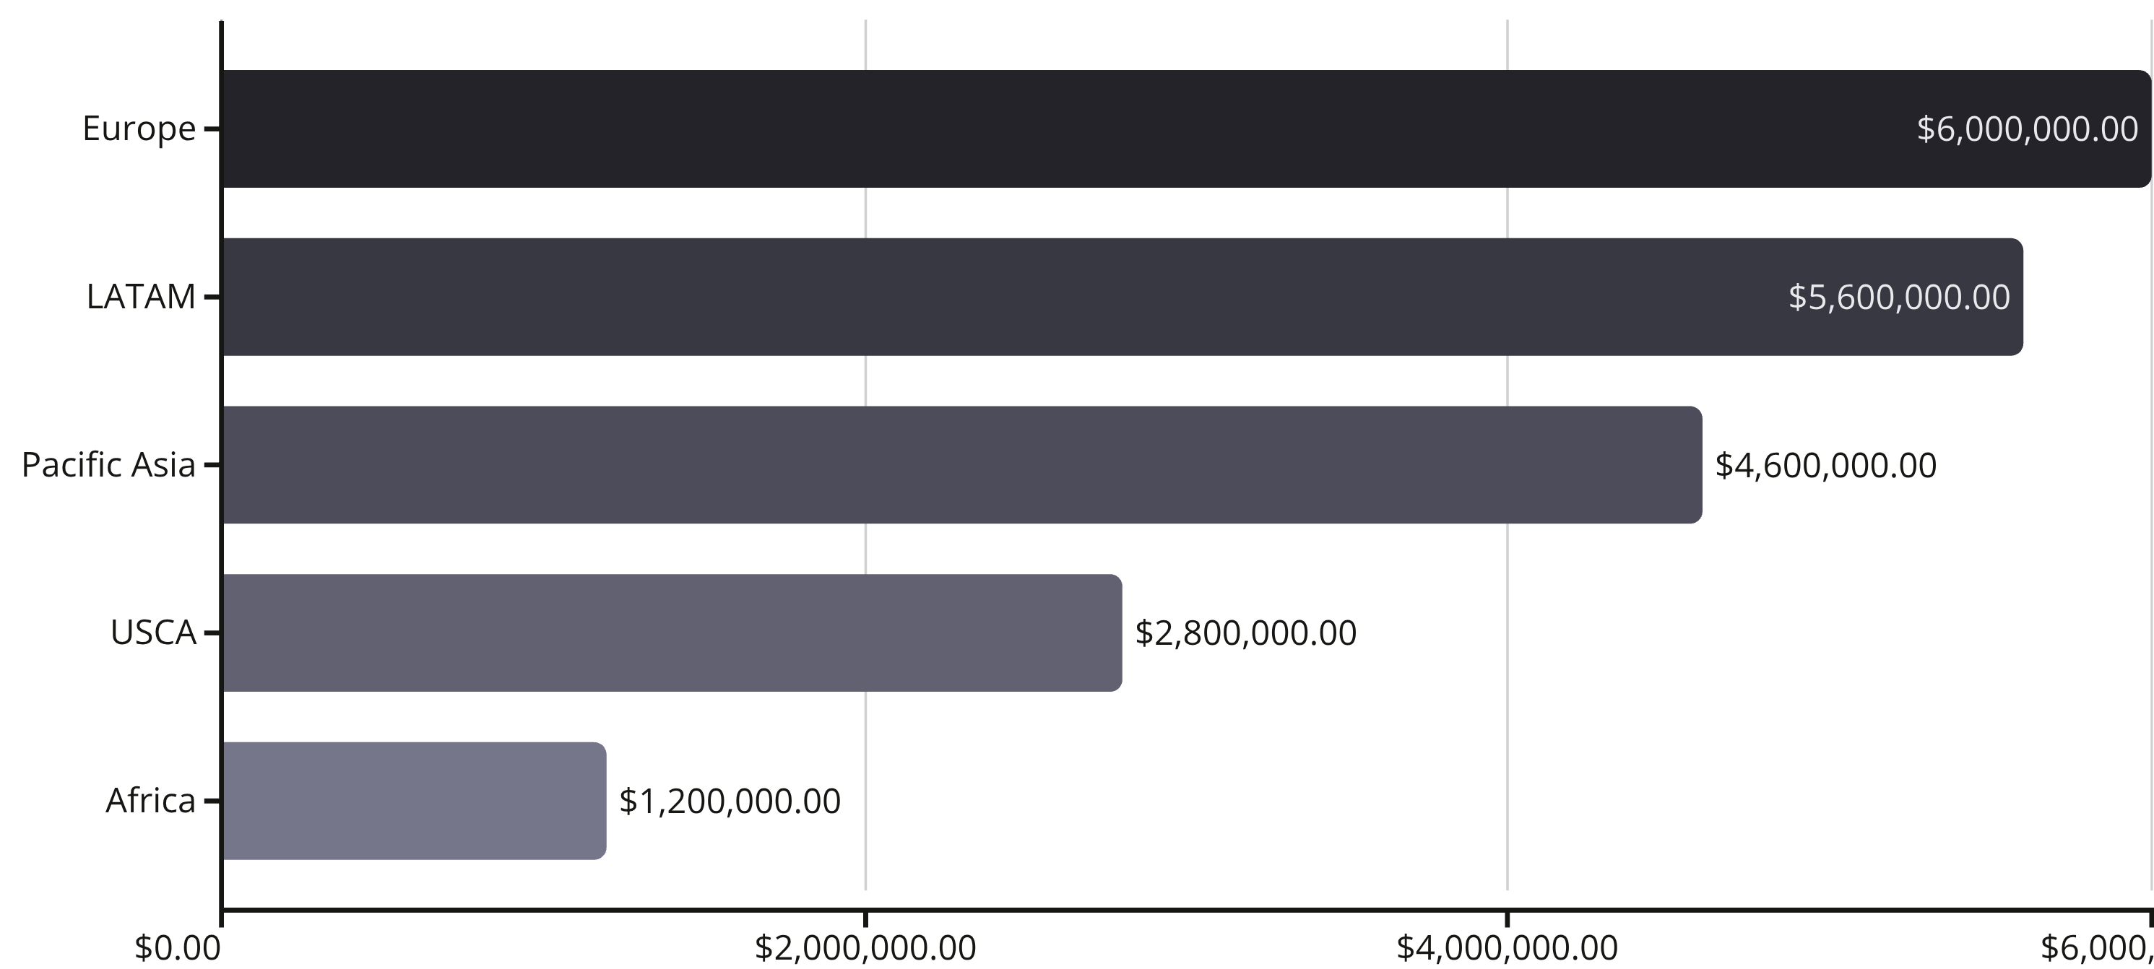

Geographic Risk Distribution
Strategic Focus: Europe and LATAM account for 58% of late-delivery revenue exposure, requiring immediate targeted intervention and process improvements.

Slide 8

Category Analysis
1
Fishing Equipment
2
Cleats & Footwear
1.9M $ revenue - Clear market leader requiring priority service reliability
1.2M $ revenue - Strong secondary category with consistent demand
3
Camping & Hiking
1.2M $ revenue - Outdoor sports driving significant volume
Prioritisation Strategy: Focus service improvements on top revenue categories first, ensuring availability and reliability for core business drivers.
Notes:
Poor inventory planning

Slide 9

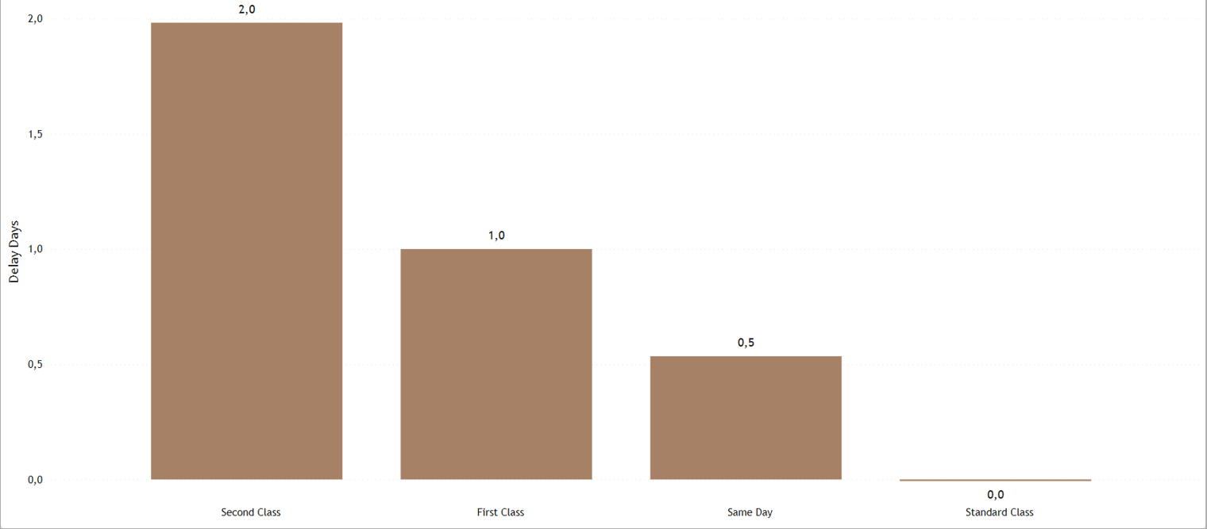
Shipping Mode Performance Analysis
Worst: Second Class (2.0 days avg delay)
Best: Standard Class (0.0 days avg delay)
Action: Review carriers & SLAs for Second Class

Slide 10
Revenue Distribution Analysis
The business is predominantly driven by lower-priced items, with 97.5% of revenue from products under $500. This concentration suggests mass-market focus with volume-based profitability.
Late orders are heavily concentrated in COMPLETE (~9.9K late of ~17.4K) and PENDING_PAYMENT (~6.8K of ~11.7K), indicating SLA/promise-date misalignment and payment clearance delays as primary drivers.
Meaningful late volumes in PROCESSING/PENDING (3.5–3.7K each) show upstream operational bottlenecks; lateness persists across the entire flow, not just early stages.
Prioritize fixes: realign promise dates to carrier cutoffs, implement a payment fast‑lane, and reduce PROCESSING dwell time to capture the largest impact quickly.

Slide 11
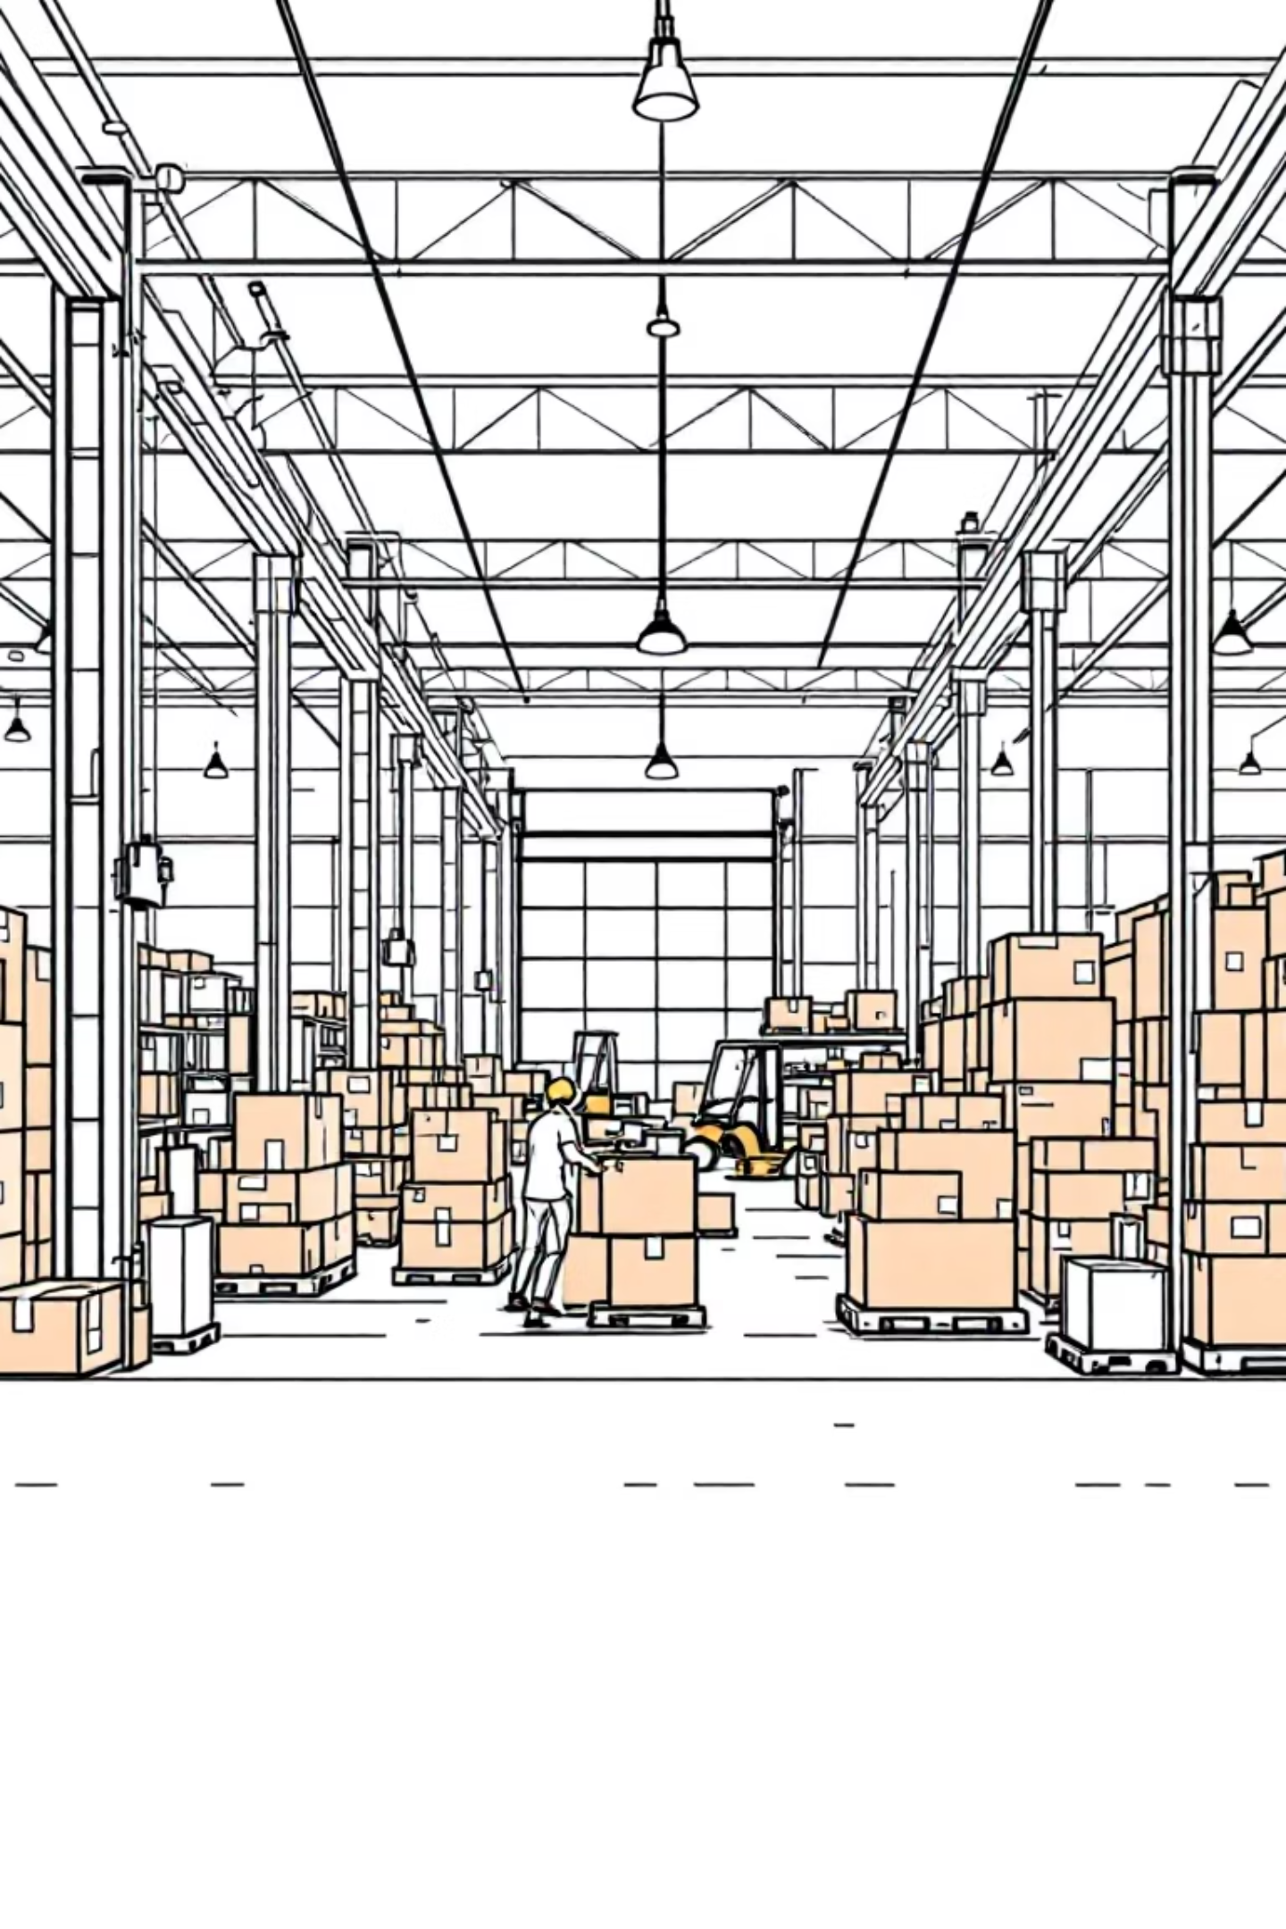

Order Status & Delivery Performance Matrix
Complete Orders (18.8% Late)
Pending Payment (12.6% Late)
Even completed orders miss promised delivery windows, indicating SLA misalignment with actual capacity
Payment friction strongly correlates with lateness - orders awaiting authorization miss carrier cutoffs
Processing Stage (7.0% Late)
Pick/pack cycle times exceed promised SLAs, creating operational bottlenecks
Critical Insight: Lateness is systemic across all order stages, not isolated to early processing. Promise dates and dispatch cutoffs require immediate realignment.

Slide 12

Strategic Action Plan
01
Immediate SLA Realignment
Realign promise dates with actual cutoffs by shipping mode. Set stricter same-day cutoffs with automated alerts.
02
Payment Fast-Lane Implementation
Deploy pre-authorization, faster retries, and prioritized picking once cleared to avoid missing carrier windows.
03
Processing Throughput Optimization
Measure pick/pack lead times, add surge capacity during peaks, prioritize late-risk orders for processing.
04
KPI Tracking & Monitoring
Weekly late delivery % tracking by mode and status. Target 5-8 point reduction in 60-90 days, starting with Second Class.

Slide 13
Thank you!

